Slide 1
Molecular Dynamics Simulation of Water and Ice by TIP5P Code
Motohiko Tanaka, Ph.D., Professor
Graduate School of Chubu University
Kasugai 487-8501, Japan

Slide 2
水の誘電定数 [Ref. 3]
温度により誘電率が変わる。氷は誘電率が増加する。
(Hobbs, Jhon, Eyring, PNAS, 1966)
Water T (K), Dielectric constant of liquid
273 K 88 <- 298 K, をモデル化。
373 K 56
473 K 35
Ice I, T (K), Dielectric constant
273 K 91.5
262.3 K 95.0
252.2 K 97.4
241 K 100
228.4 K 104 <- 230 K, をモデル化。
216.3 K 114

Slide 3
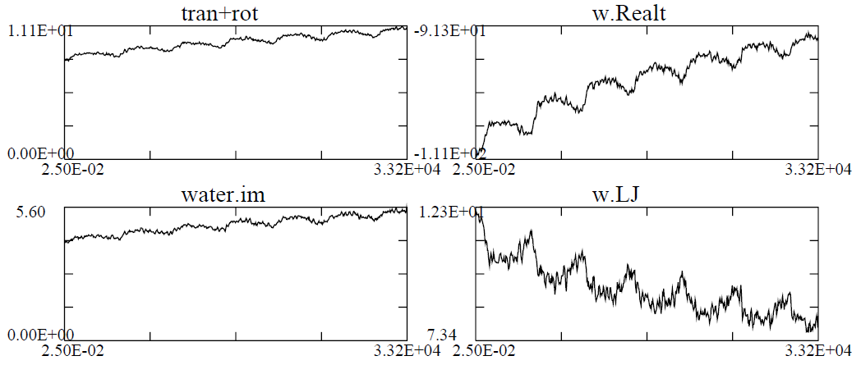
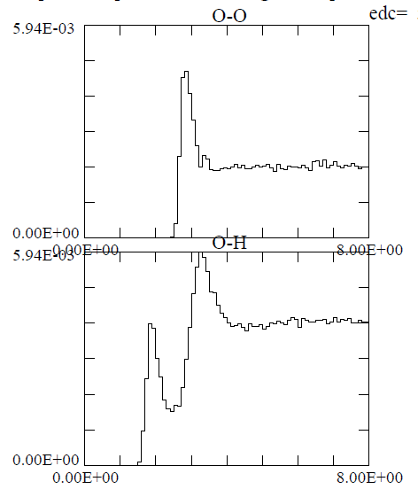
* Simulation water starting from 298 K *
Time t=33,200 starting from 298 K with 1728 water molecules, imposed electric field 10 GHz in x-direction with E_0= 5x10^6 V/cm (about 3.2 periods).
Left: a) Total kinetic energy, b) rotational energy only, c) Coulombic energy, Lennard-Jones energy.
Right: Pair distribution functions of a) O-O atoms,
b) O-H atoms in R=0-8 Angstrom. O and H atoms
are thus mixed showing heavy water interactions. Compare with the frozen ice of 230 K.

Slide 4
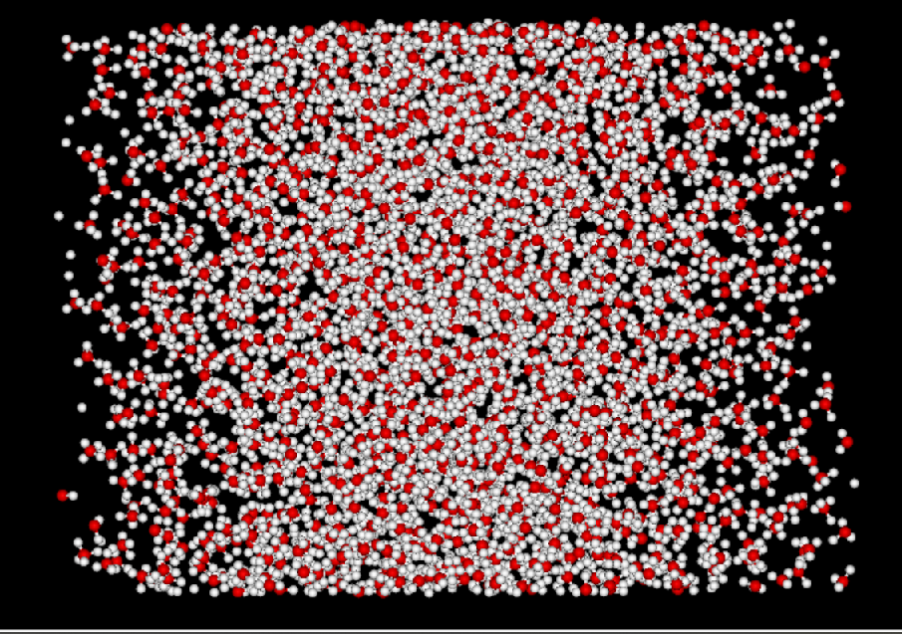
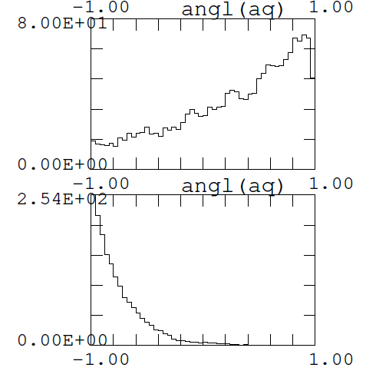
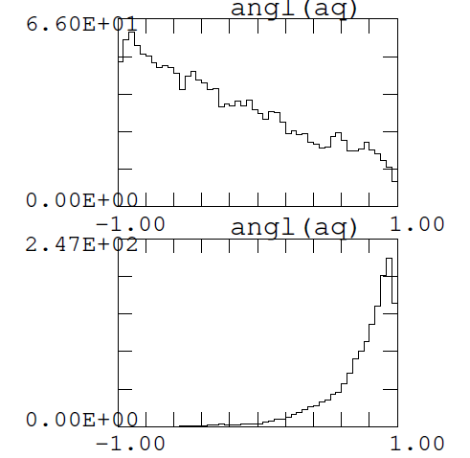
Water molecules at 298 K.
Left: Scatter plot of water at t=32,500, b) x-directional
cosine distribution for the cross bins of (-1.0,1.0) at
t=27,500 to 32,500. Due to phase lag of molecules
compared to imposed electric field, water is largely
heated,

Slide 5
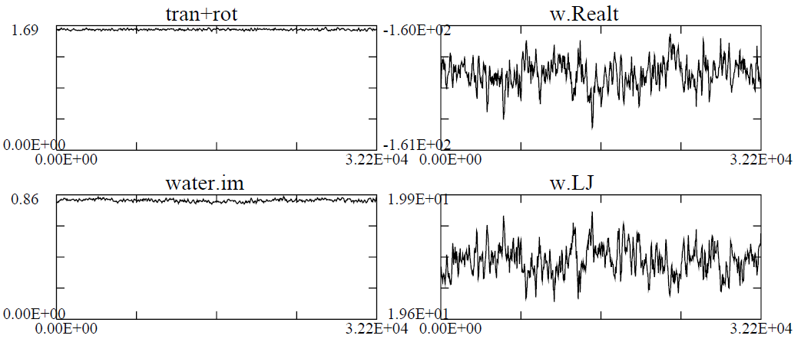
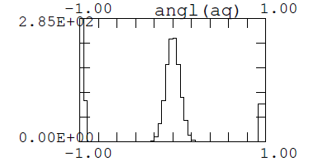
* Simulation starting from ice at 230 K *
At temperature 230 K of 1728 water molecules,
AC electric field 10 GHz in the x-direction with
intensity E_0= 5x10^6 V/cm. Left: a) total kinetic
energy, b) rotational energy only, c) Coulombic
energy, d) Lennard-Jones energy, at time of
t=32,300. Right: cosine distribution of water in
Bins (-1,1) of the x-direction. No oscillations
are really found at the imposed large electric field.

Slide 6
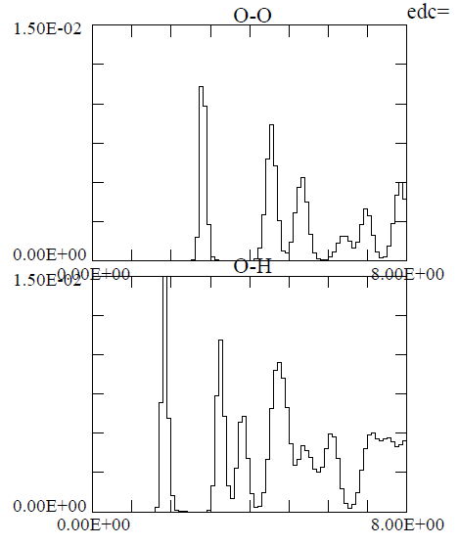
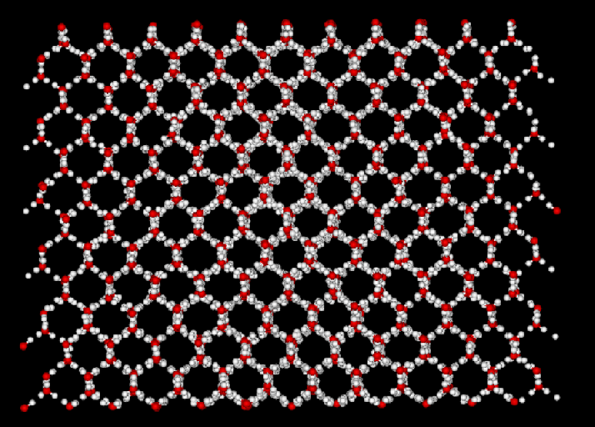
Time t=30,000 of temperature 230 K.
Left: a) Pair distribution functions of O-O atoms
b) O-H atoms for R=0-8 Angstrom. Peaks are
well separated at this temperature.
Right: Scatter plot of water molecules where
6-membered rings are formed for frozen ice.

